Slide 1
Vera Sale
Driving Value and Strategy Through Data

Slide 2
About me
I’m passionate about creating intuitive products that make a real-world impact. With 4 years of experience in data-driven projects and sustainability, I bring ideas from research to life.
Growing up in Northern Italy, I developed a love for music and climbing, and I’m currently training for my first triathlon.
I’m excited to connect and build meaningful solutions together!

Slide 3
Skills & expertise
Product development
User experience
Strategic thinking
Project management
Data science

Slide 4
Portfolio samples

Slide 5
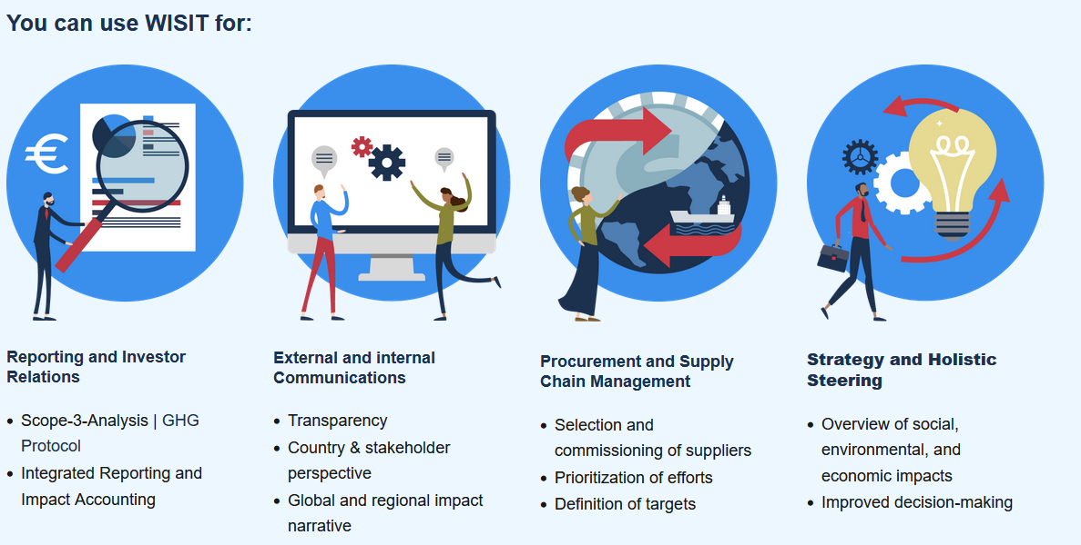
WISIT
The WifOR Institute Sustainability Tool
Link to demo video: https://www.wifor.com/en/wisit-the-wifor-institute-sustainability-impact-tool/
WISIT is a web application for analyzing the social, environmental, and economic impacts of business activities. It allows for the calculation of impacts along the supply chain up to the final sales product in three simple steps.
End-users: international corporate clients, policy-makers, researchers

Slide 6

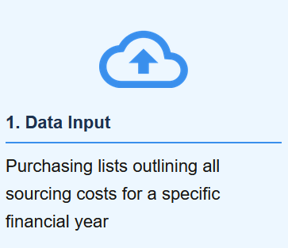
Use case : upstream supply chain analysis
Model Database:
188 countries
56 sectors
Updated regularly with latest data and inflation rates
Step 1 - Data input & model selection
Input of so-called spend data and choice of the macroeconomic model to be used by the calculation

Slide 7
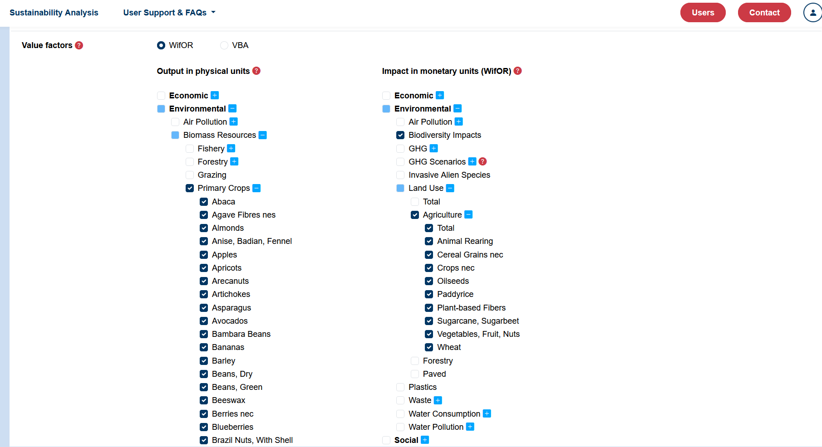
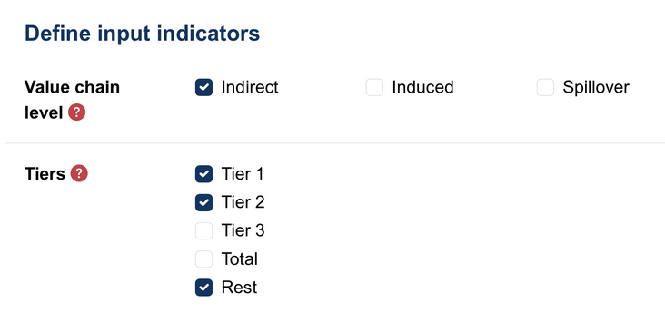
Use case : upstream supply chain analysis
Step 2 - Data configuration
Select the variables you are interested in and the value chain level

Slide 8
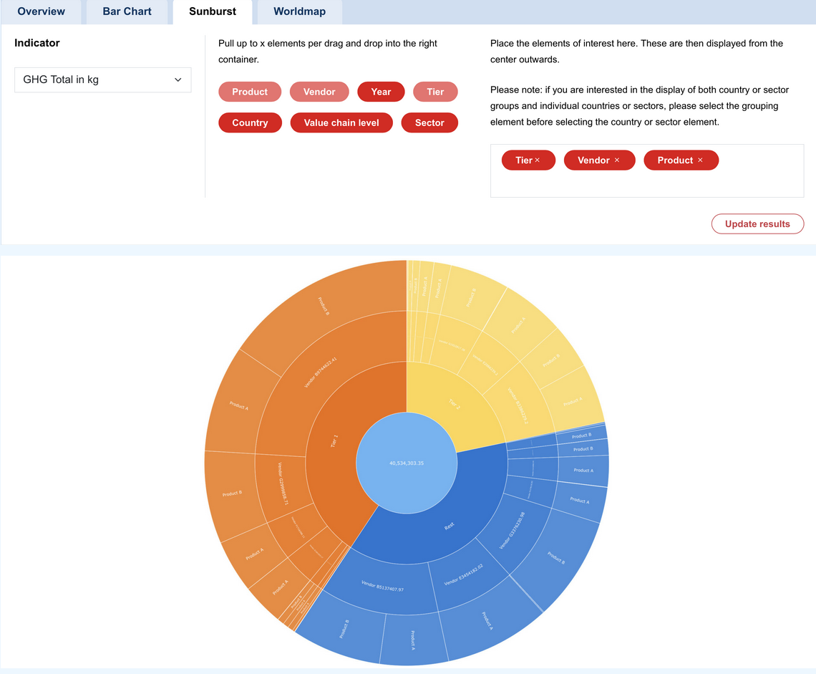
Use case : upstream supply chain analysis
Step 3 - Explore results
Explore results in data (.csv, .xlsx) format or graphical output
Available graphs entail: Bar chart, sunburst, world maps of supply chain impact

Slide 9
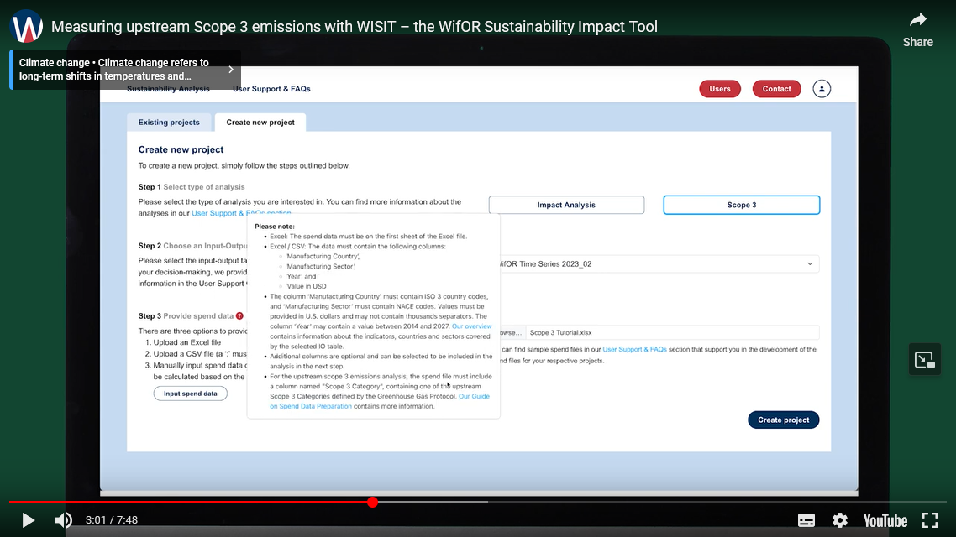
Use case : Scope 3 calculation
Scope 3 calculation based on procurement data input is available in WISIT
Models and calculations are updated to the latest GHG Protocol and industry requirements
Follow the link on the right for a demonstration of the app’s usability and results display
https://www.wifor.com/en/research/sustainability-research/scope-3-assessment/

Slide 10

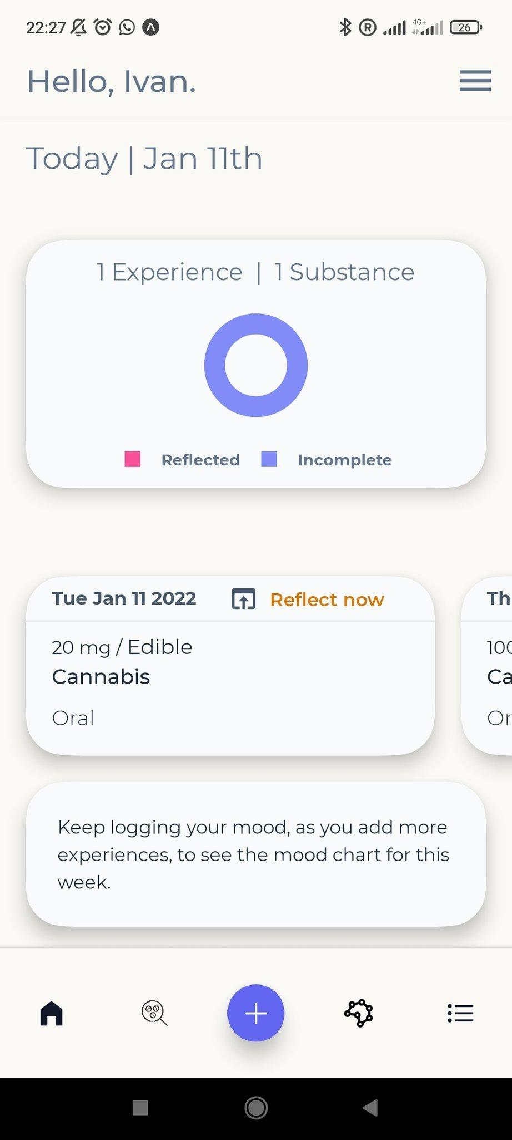
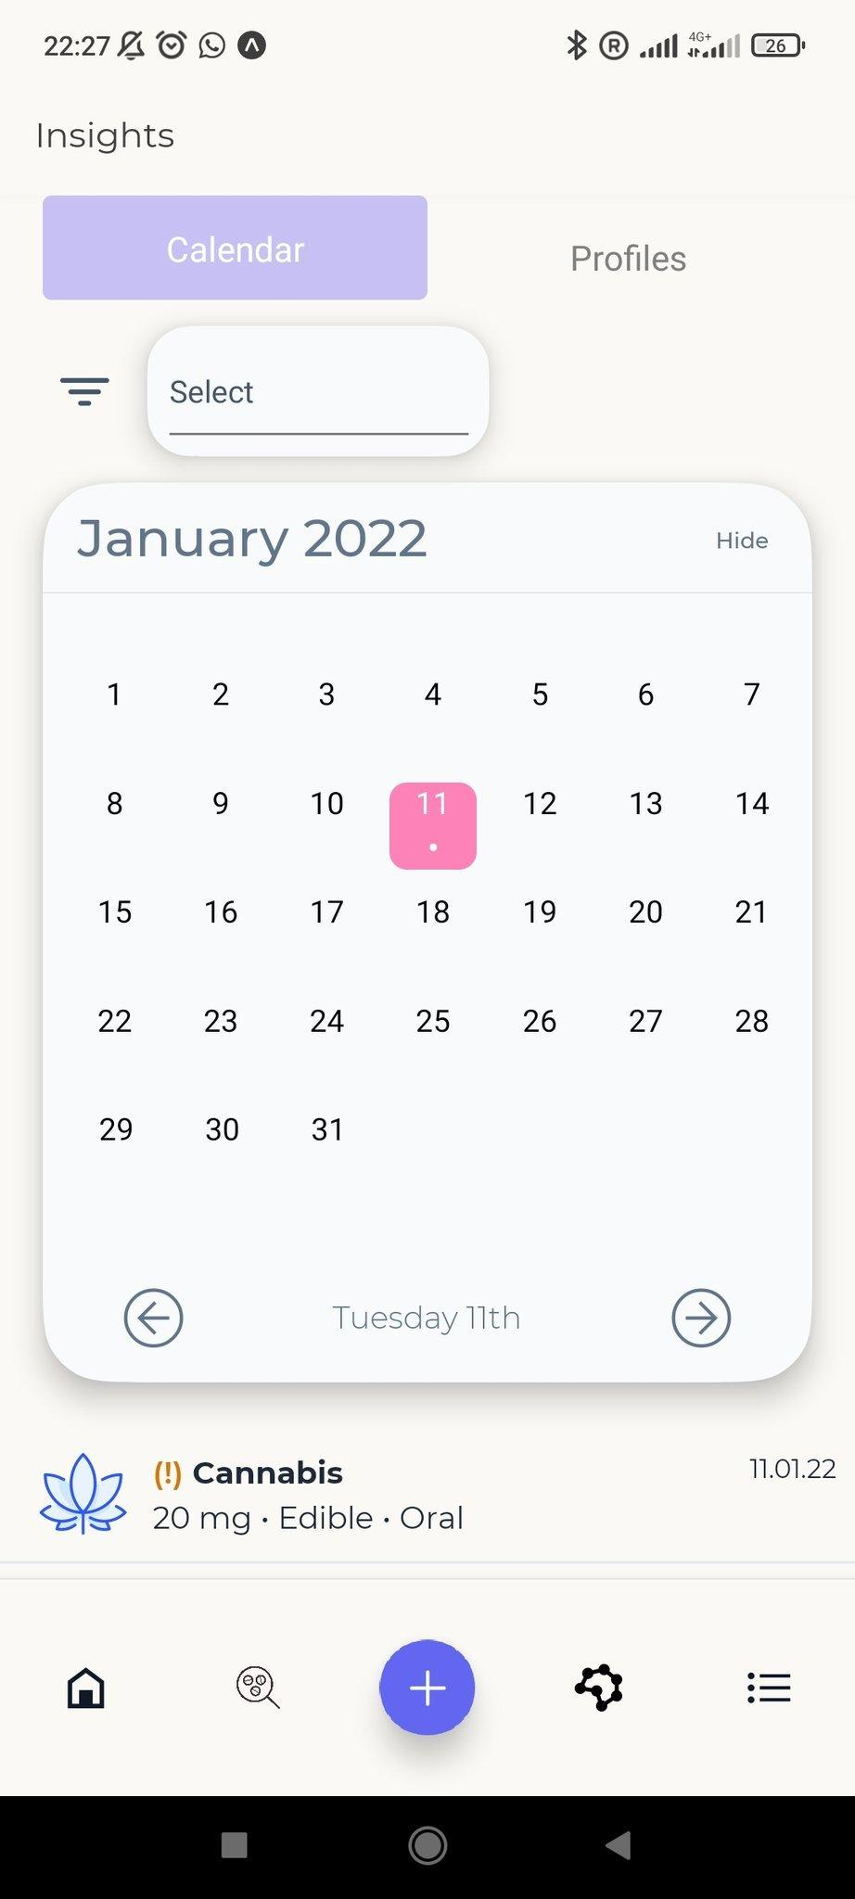
Sojourn well-being
Sample user journey
The Sojourn Wellbeing App, created with Drugs and Me, is a self-tracking tool for substances like caffeine, alcohol, and nicotine, promoting harm reduction
It is inspired by the UK-based organization’s mission to provide innovative digital tools for informed drug use management
1.Log experience
2. Add to calendar

Slide 11
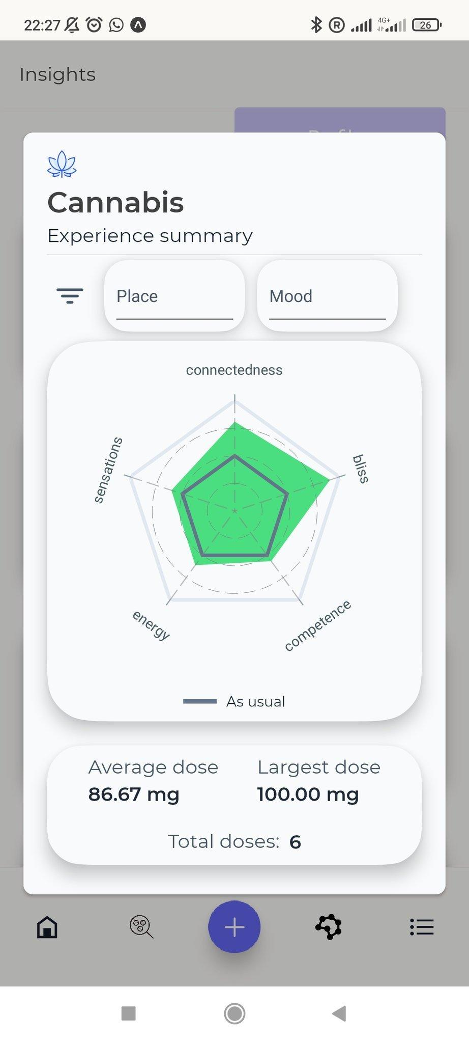
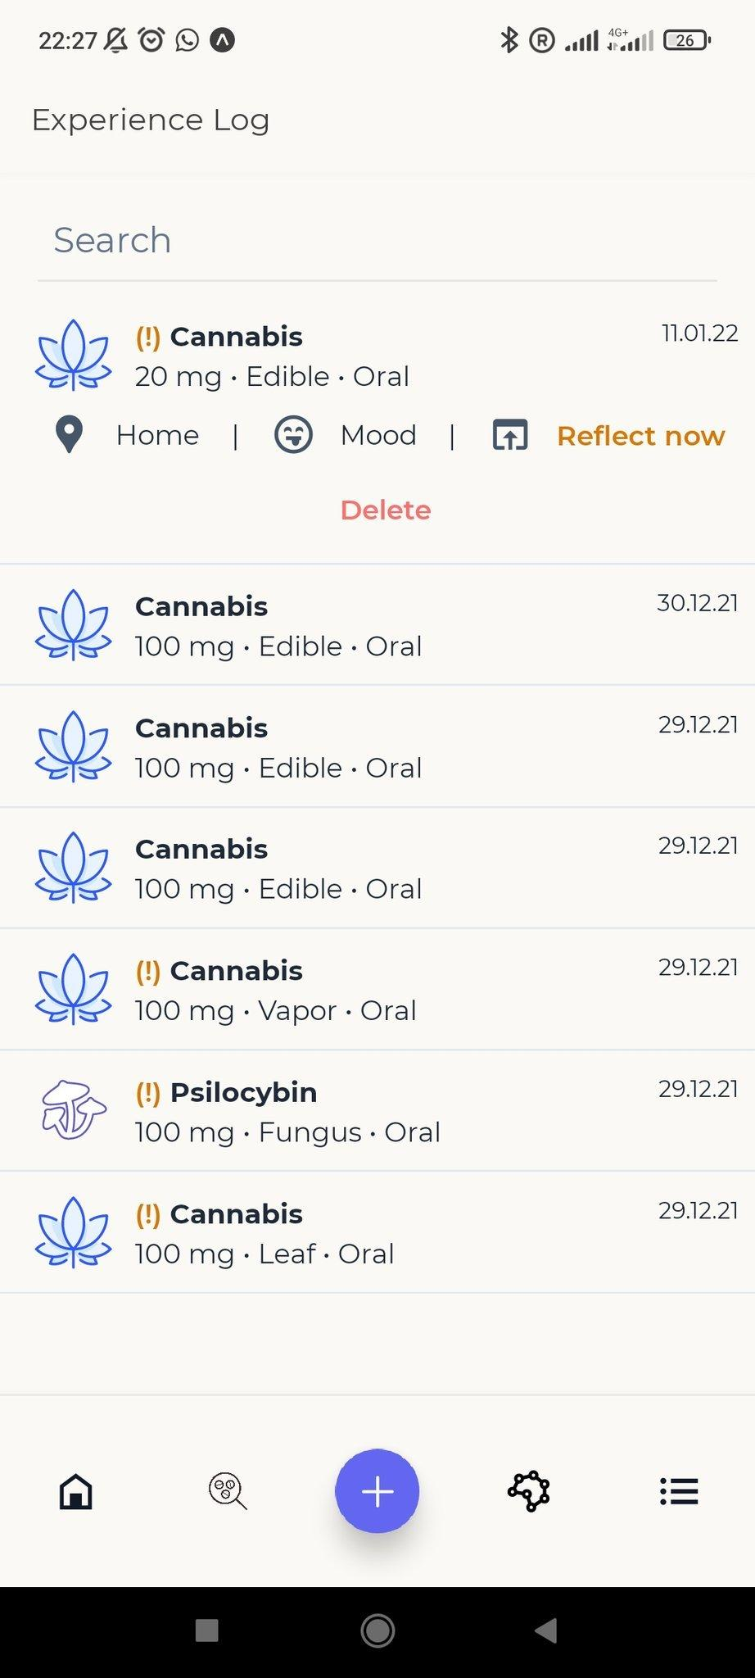
Sojourn well-being
Sample user journey
I led user research, focus groups, managed the beta phase, and coordinated development to deliver a user-centred design
It was launched as a beta product on the app store (Android and Apple App Store)
https://www.drugsand.me/
3.Experience results overview
4. Log summary

